Slide 1
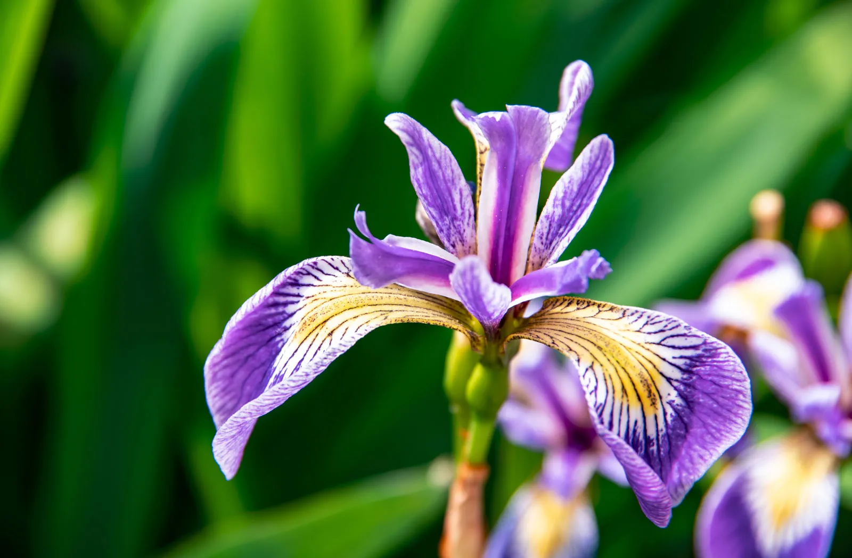




UNLOCK INSIGHTS
FROM IRIS DATA

Slide 2



DATASET
INFORMATION
150 ROWS
5 COLUMNS
Petel
SEPEL LENGTH
PETEL LENGTH
SEPEL WIDTH
PETEL WIDTH
SPECIES
Sepel

Slide 3
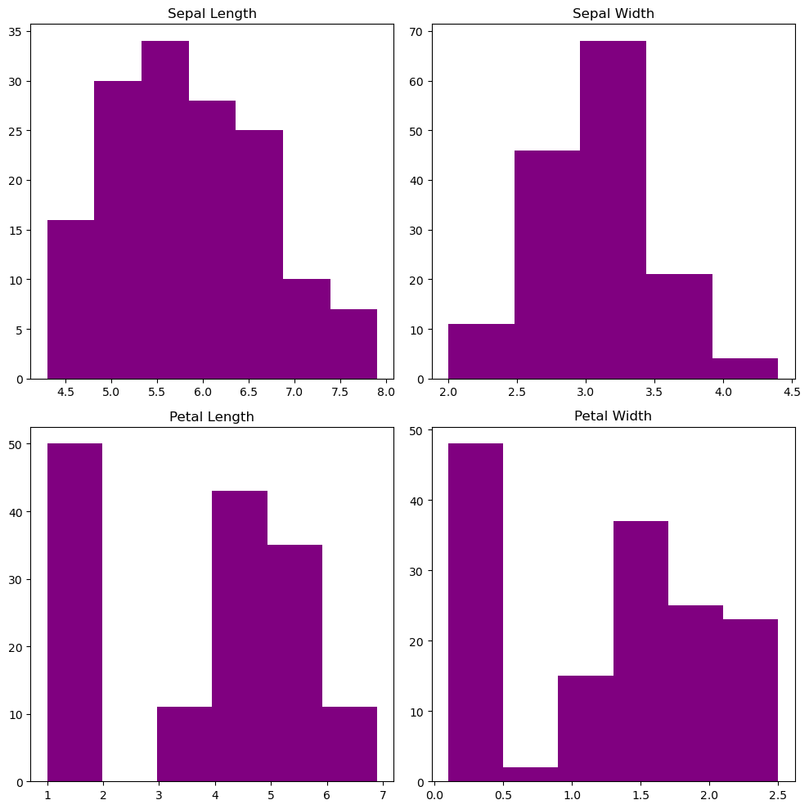



ANALYZING DISTRIBUTION

Slide 4
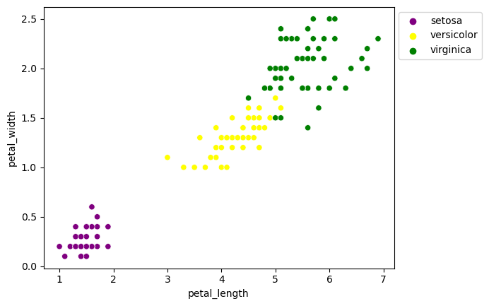
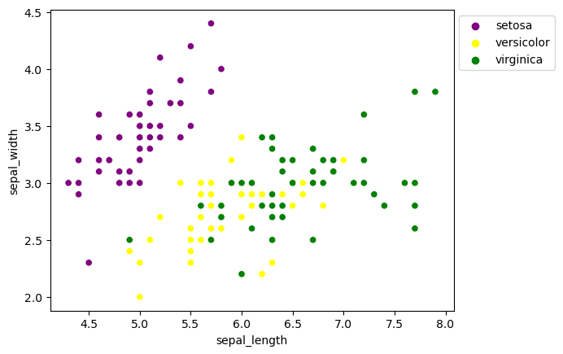
EXPLORING RELATIONSHIPS

Slide 5

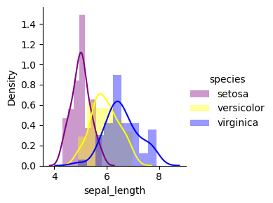
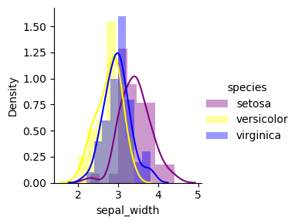
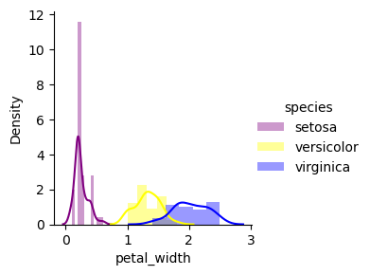
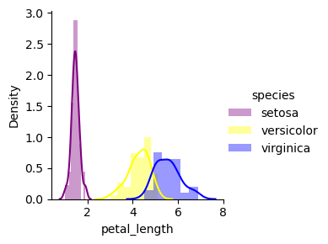
VISUALIZATION
SETOSA
VERSICOLOR
VIRGINICA

Slide 6
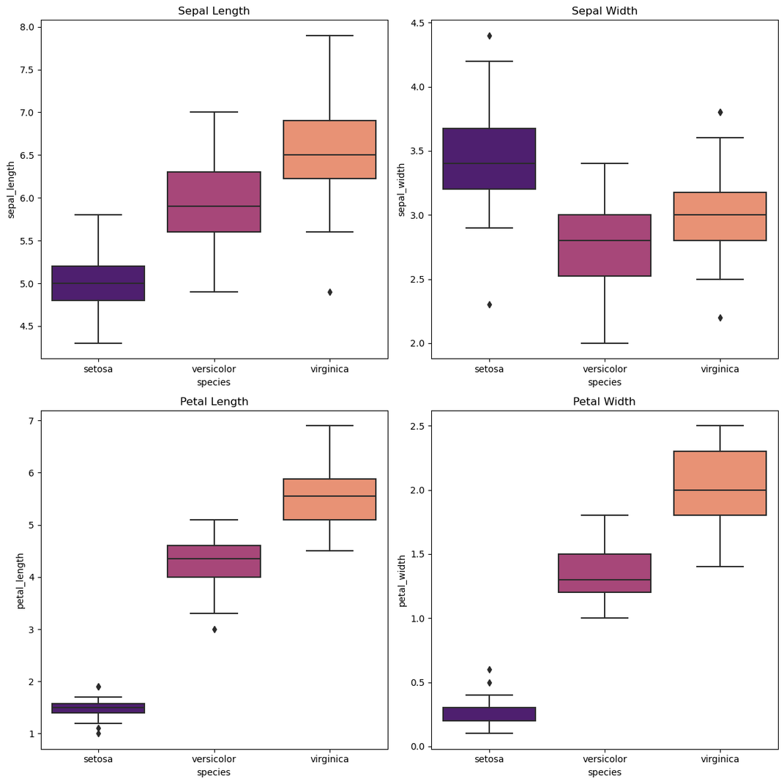
EXAMINING THE FEATURE DISTRIBUTIONS WITH BOX PLOTS

Slide 7




CLASSIFICATION
DECISION TREE
PRE- PROCESSING
FITTING
MODEL
OUTPUT

Slide 8
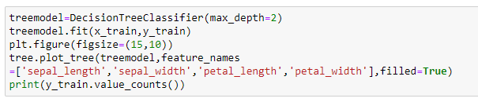
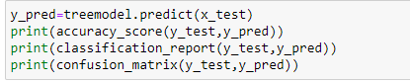

CODE
SNIPPET

Slide 9
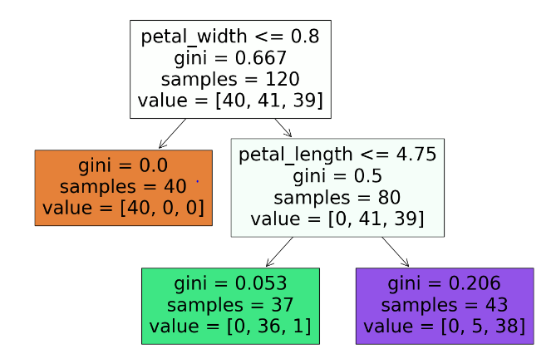


TREE PLOT (OUTPUT)

Slide 10

ACCURACY_SCORE
0.97(97%)
METRICS
CONFUSION MATRIX
DECISION TREE MODEL HAS ACHIEVED AN IMPRESSIVE ACCURACY SCORE OF 96% DEMONSTRATING ITS EFFECTIVENESS IN CORRECTLY CLASSIFYING THE DATA.
0
1
2
[10 0 0]
[ 0 8 1]
[ 0 0 11]
0
1
2

Slide 11


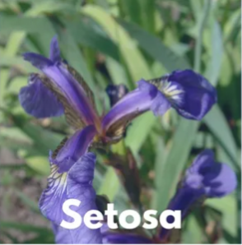


LINEAR DISCRIMINANT ANALYSIS (LDA)
CLASSIFICATION
NAIVE BAYES
COMPARISON OF RESULTS

Slide 12
PURPOSE
WHY LDA?
LDA
ADVANTAGE OF IT

Slide 13
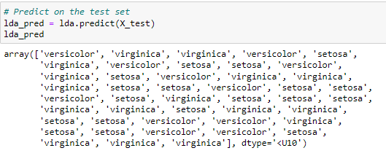
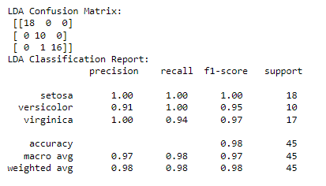
Trained the LDA model and made predictions
Evaluated model performance using
confusion matrix and classification report

Slide 14

PURPOSE
NAIVE BAYES
WHY NAIVE BAYES
ADVANTAGE

Slide 15
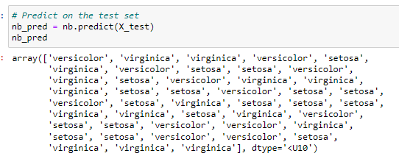
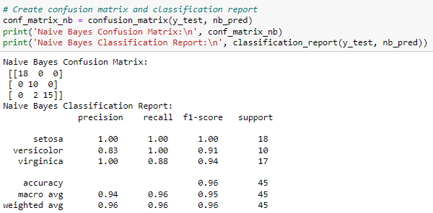
Trained the Naive Bayes model
and made predictions
Evaluated model performance using
confusion matrix and classification
report.

Slide 16
COMPARISON
LDA Results:
Naive Bayes Result:
1)High accuracy (98%)
2)Confusion matrix shows most predictions are correct with minimal misclassification
3)Particularly strong performance on all three species.
1)High accuracy (96%), slightly lower than LDA.
2)Confusion matrix shows a few more misclassifications compared to LDA, especially for Virginica.
3)Good performance overall with excellent precision and recall for Setosa and Versicolor.

Slide 17

Conclusion
1)Both LDA and Naive Bayes are effective for classifying Iris species.
2)LDA is slightly more accurate, making it a better choice for this specific dataset.
3)Future work could explore other classifiers and additional feature engineering to further improve classification performance.

Slide 18
THANK YOU

